Slide 1
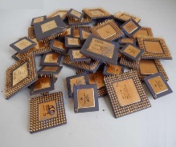
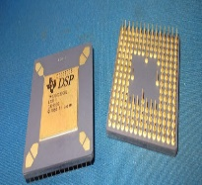
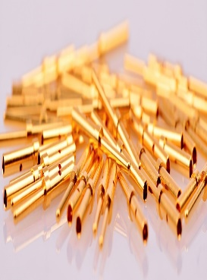
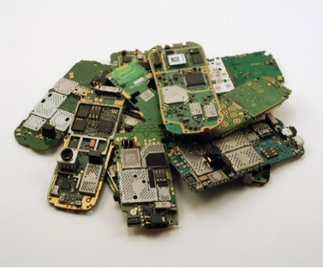
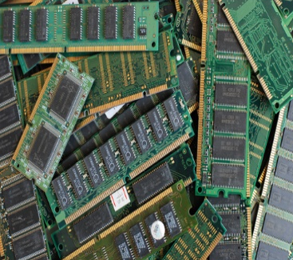
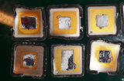
Our New Technology
Electronics Waste Recycling Innovative Technology for Gold and Silver
JSC EPT presents a novel product EWRITS (electronics waste recycling innovative technology for gold and silver recovery) designated for SMEs active in WEEE (waste electric and electronic equipment) collection, and/or recycling. The cutting-edge efficient and environmentally friendly way for gold leaching and recovery was developed. It includes mechanical & chemical processes and equipment for the treatment of WEEE.
Au
Ag
Au
! Applying EWRITS you contribute to a Greener Future by avoiding contamination of
by ~ 50 000 m³ of NO_{x} or ~ 2 tons of nitrates per 1 ton of WEEE recycling

Slide 2
Our New Technology
Electronics Waste Recycling Innovative Technology for Gold and Silver
Newly developed innovative technological system for electronic waste recycling:
It is productive, economic, efficient, optimal and adapted for extraction of precious metals (Au an Ag)
Au
A comparison of the recycling process in proposed technology vs other providers (e.g. Germany)
 | Min. delivery (kg per lot) | Recycling and Au extraction period | Pricing model
EWRITS | 5-10 | 10 days | System installation costs
Other providers | 1000 | 16-18 weeks | Transportation Processing cost Refining cots
Ag
Productivity Indicators of two people working full working day
Reactor capacity, kg of WEEE | Treatment efficiency, kg/month
50 | 650-850

Slide 3
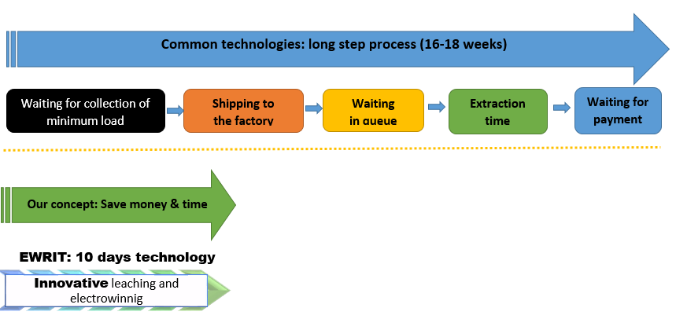
Our New Technology
Electronics Waste Recycling Innovative Technology for Gold and Silver
You are losing money on logistics, transportation, while your assets are frozen. Chose better!
Au
Ag
You control the process
You control the extraction, so you know an exact content of gold is in your raw material | You don’t lose the gold by mixing rich-Au with less-Au components to attain the minimum load per factory requirements. | A more effective extraction! Proven!

Slide 4
Our New Technology
Electronics Waste Recycling Innovative Technology for Gold and Silver
Au
Types of treated waste
Ceramic processors Textolytic processors Telephone boards Gold-plated connectors or other Au / Ag coated parts (e.g. transistors, Au / Ag coated metal parts) | Computer RAM cards Computer motherboards WEEE containing (coated) Au / Ag (telecommunication boards (KVANT, KVARC and similar station boards), microchips coated with Au / Ag, microchips containing Au and other similar electronic wastes containing Au and Ag)
Ag

